Slide 1
The ctl for EKS
A cluster-centric approach

Slide 2
Amazon Elastic Kubernetes Service (EKS)
EKS is a platform to run production-grade workloads—security and reliability are our ﬁrst priority.
EKS provides a native and upstream Kubernetes experience. This means, with EKS you get vanilla, un-forked Kubernetes. In keeping with our ﬁrst tenant, we ensure the Kubernetes versions we run have security-related patches, even for older, supported versions as quickly as possible.
If you want to use additional AWS services, the integrations are as seamless as possible.
The EKS team in AWS actively contributes to the upstream Kubernetes project and the wider CNCF activities, both on the technical level as well as community, from communicating good practices to participation in SIGs and working groups.

Slide 3
A quick EKS review
April – June 2018:
EKS achieves Kubernetes conformance, HIPAA-eligibility, Generally available
July – September 2018:
Amazon EKS AMI build scripts and CloudFormation templates available in GitHub
Support for GPU-enabled EC2 instances, support for HPA with custom metrics
Launches in Dublin, Ireland
October – December 2018:
Adds support for Dynamic Admission Controllers (Istio), ALB Support with AWS ALB Ingress Controller
Launches in Ohio, Frankfurt, Singapore, Sydney, and Tokyo
Adds Managed Cluster Updates and Support for Kubernetes v1.11
CSI Driver for EBS

Slide 4
A quick EKS review
2019:
Launches in Seoul, Mumbai, London, and Paris
Achieves ISO and PCI compliance, announces 99.9% SLA, cluster creation limit raised to 50
API Server Endpoint Access Control, AWS App Mesh controller, Windows support (preview)
Kubernetes version 1.12, CSI Drivers for EFS, FSx for Lustre
Control Plane Logs, A1 (ARM) instance support (preview)
Kubernetes v1.13
Deprecation policy
Deep Learning Benchmark Utility, Public IP Address Support
Simpliﬁed cluster authentication, SOC compliance
IAM roles for service accounts

Slide 5
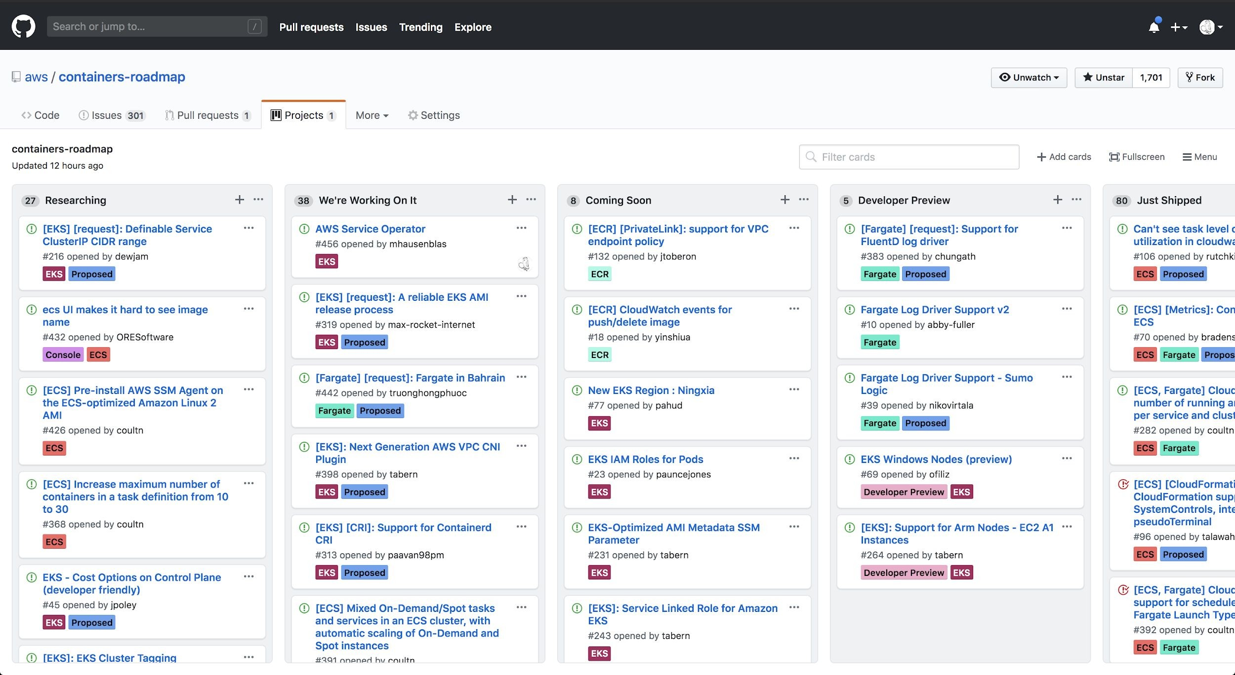
EKS has a public roadmap
https://github.com/aws/containers-roadmap/

Slide 6
What is eksctl?
Open source project by Weaveworks in collaboration with AWS
Minor release every 2 weeks, with occasional patch release
1 year old:
2018: ﬁrst alpha release in June, and 0.1.0 in August
July 2019: 0.1.40
August 2019: 0.4.3
Focused on developer experience
Growing community

Slide 7
Cluster-centric vs Resource-oriented

Slide 8
Current use-cases
Create a cluster in one step
Create a cluster in an existing VPC
Manage multiple nodegroup with diﬀerent conﬁgurations
EC2 tags and Kubernetes labels
spot instances
private/public subnets
Amazon Linux 2, Ubuntu 18.04 and custom AMIs
custom bootstrap scripts
instance roles
extra SGs
Customise cluster conﬁguration using YAML or JSON API

Slide 9
Basic CLI usage examples
Create cluster
Add extra nodegroup
Scale nodegroup
Delete nodegroup
Write kubeconﬁg
Describe cluster stack details
Upgrade cluster
Add nodegroup with spot instances

Slide 10
Conﬁg ﬁle example 1
apiVersion: eksctl.io/v1alpha5 kind: ClusterConfig
apiVersion: eksctl.io/v1alpha5 kind: ClusterConfig
metadata:
name: example-1a region: eu-west-3
metadata:
name: example-1b region: eu-west-3
nodeGroups:
- name: ng-1 instanceType: m5.large desiredCapacity: 10
nodeGroups:
- name: ng-1 instanceType: m5.xlarge minSize: 4
maxSize: 16 privateNetworking: true

Slide 11
Conﬁg ﬁle example 2
apiVersion: eksctl.io/v1alpha5 kind: ClusterConfig
nodeGroups:
- name: ng-1 instanceType: m5.xlarge desiredCapacity: 2 privateNetworking: true securityGroups:
attachIDs: [sg-0b85ff315ea644478] iam:
instanceProfileARN: "arn:aws:iam::..." instanceRoleARN: "arn:aws:iam::..."
metadata:
name: example-2 region: eu-west-3
vpc:
subnets: private:
eu-west-3a: {id: "subnet-0b2512f8c6ae9bf30"} eu-west-3b: {id: "subnet-08cb9a2ed60394ce3"}
iam: {serviceRoleARN: "arn:aws:iam::123:..."}

Slide 12
Conﬁg ﬁle example 3
apiVersion: eksctl.io/v1alpha5 kind: ClusterConfig
- name: ng-1 instanceType: m5.xlarge minSize: 2
maxSize: 8
volumeSize: 100 volumeType: gp2
labels: {nodegroup-type: frontend-workloads} iam:
withAddonPolicies: {autoScaler: true}
metadata:
name: example-3 region: eu-west-3
nodeGroups:
- name: ng-2 instanceType: c3.8xlarge desiredCapacity: 4
labels: {nodegroup-type: very-special-science-workloads} taints: {special: "true:NoSchedule"}
privateNetworking: true availabilityZones: ["eu-west-3a"] preBootstrapCommands:
- disable_hypethreading.sh

Slide 13
Roadmap themes
GitOps quickstart:
create a cluster with Flux, Tiller and ALB Ingress controller pre-installed
Declarative cluster conﬁguration:
eksctl apply & Cluster API
Cluster add-ons:
SIG Cluster Lifecycle add-ons spec

Slide 14
Next steps

Slide 15
Let’s Connect
Join the community Slack: slack.weave.works
Github: weaveworks/eksctl
Twitter:
@errordeveloper @weaveworks @mhausenblas @awscloud

